Slide 1
2016 US Primaries
Demographics analysis.
DRAFT

Slide 2
Agenda
Team
Problem statement & meeting purpose
Data overview
Gaps reconciliation
Results
Conclusions
Recommendations
Notes:
Presenting recommendation for DNC

Slide 3
Team
Maciej Korus - Data Scientist
Danuta Lewandowska - Data Scientist
Wojciech Sierant - Data Scientist
Filip Szulc - Data Scientist

Slide 4
Background & Meeting Purpose
Team was given a task to analyze demographics impact on 2016 US Primary elections.
Primary elections, often abbreviated to primaries, are a process by which voters can indicate their preference for their party's candidate, or a candidate in general, in an upcoming general election, local election, or by-election.
Team analyzed correlation between a number of social factors and Republican vs Democrat vote ratio.
Purpose of the meeting is to get board concurrence with presented recommendations.

Slide 5
Data overview
Source data consists of following data:
County_Facts - List of Demographics Stats presented as percent and absolute values for States and Counties
County_Facts_Dictionary - Description of Demographics Stats
Primary_Results - Number of votes for Republican and Democrat candidates presented for each State and County
For simplicity data is gathered and post processed to show only Republican vs Democrat voters and aggregated for States.
Data was post processed to show Republican vs Democrat voters to draw conclusions.
Notes:
Do poprawy

Slide 6
Gaps reconciliation
Demographics data is presented for 2670 counties out of 3006 all counties in the United States. This represents 89% of the population.
Gaps do not follow any pattern and do not adversely affect the statistical significance of conclusions.
89% of counties are represented in the analysis. Gaps do not have an appreciable impact on conclusions and recommendations.

Slide 7
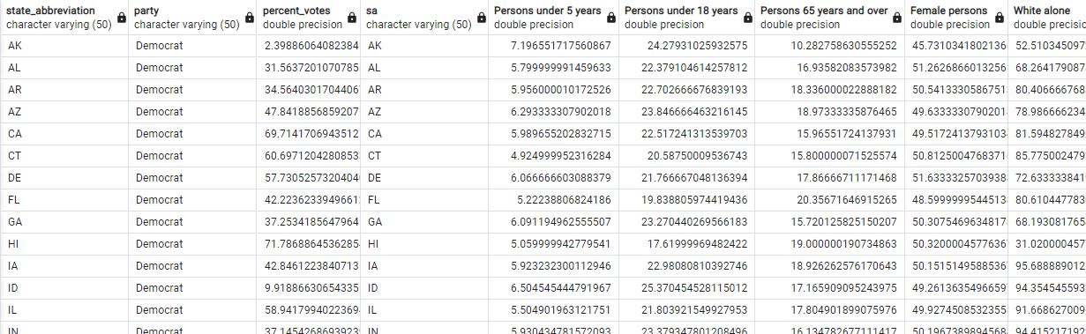
Results (backup)
Demographic facts are presented as % value per state for selected stats.
State_abbrevitaion joins primary results and demographics
Percent_votes are displayed in relation to Democrat votes, Republican votes are 1-Democrat
Percent votes are related to Democrat votes, which represent Democrat/Republican vote ratio.
Notes:
How to account for invalid votes, missing votes - check missing votes TO DO

Slide 8
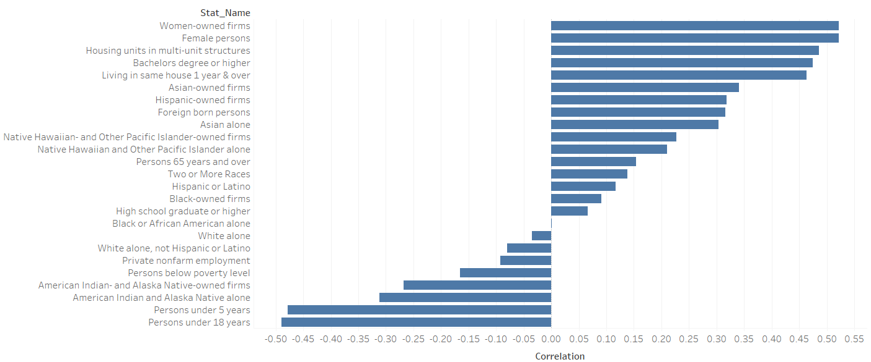
Results
Republican (-)
Democrat (+)
Biggest pro democrat correlation is with % of people of color, living conditions and women empowerment. Biggest pro Republican correlation is with % of young people, poverty, and native Americans.
#dataisbeautiful
Notes:
Do research on primaries
How population reflects votes significance?
Votes vs coefficient trendline can show how strong is the correlation

Slide 9
Conclusions
Democrat votes have strongest correlations with women owned firms and housing conditions.
Republican votes have strongest correlation with % of young people, native americans, poverty, white people.
Best course of action would be to target swing states with stats that are most in line with the observed correlation.
US partisan votes are split mainly by gender, race, education, wealth.

Slide 10
Recommendations
Team recommendation is to target states where voter gap is easiest to close, and which have indicators correlating with Democrat majority states. See list below.
state_abbreviation | percent_votes | Women-owned firms | Bachelors degree or higher | Foreign born persons | Hispanic-owned firms
AZ | 47.84 | 22.67 | 18.37 | 10.54 | 10.39
LA | 50.16 | 21.03 | 15.61 | 2.14 | 0.97
PA | 51.59 | 21.96 | 20.82 | 3.14 | 0.72
NC | 49.26 | 22.56 | 19.64 | 4.95 | 0.71
NH | 46.93 | 22.02 | 30.75 | 4.21 | 0.59
WI | 48.26 | 17.70 | 20.86 | 2.53 | 0.37
MI | 48.21 | 21.02 | 19.57 | 2.64 | 0.33
WV | 52.77 | 18.92 | 14.69 | 0.92 | 0.20
MT | 45.96 | 8.00 | 22.10 | 1.51 | 0.06
Campaign funds should be focused on states close to parity with demographics that best correlate with Dem votes.
Notes:
*2016 AZ Elections - Rep won
*2020 AZ Elections - Dem won (they must have noticed this opportunity)

Slide 11
Backup
Notes:
Need to address voting gaps
Przeskalowac glosy zeby dopelnic do 100
Zrobic wykresy w tabeau

Slide 12
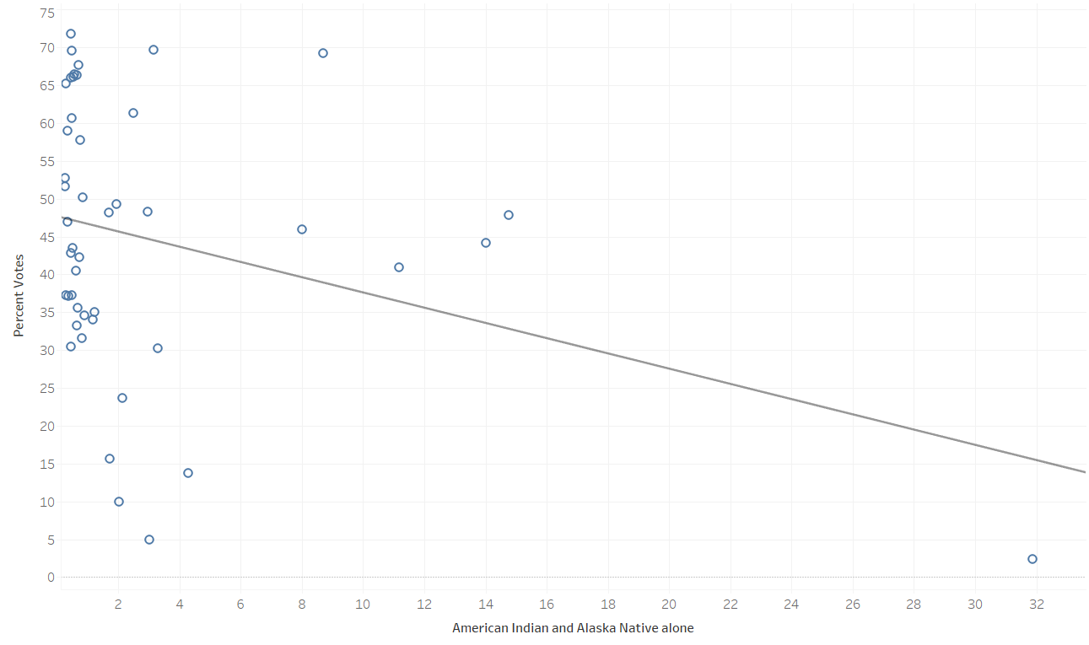
Notes:
Need to address voting gaps
Przeskalowac glosy zeby dopelnic do 100
Zrobic wykresy w tabeau

Slide 13
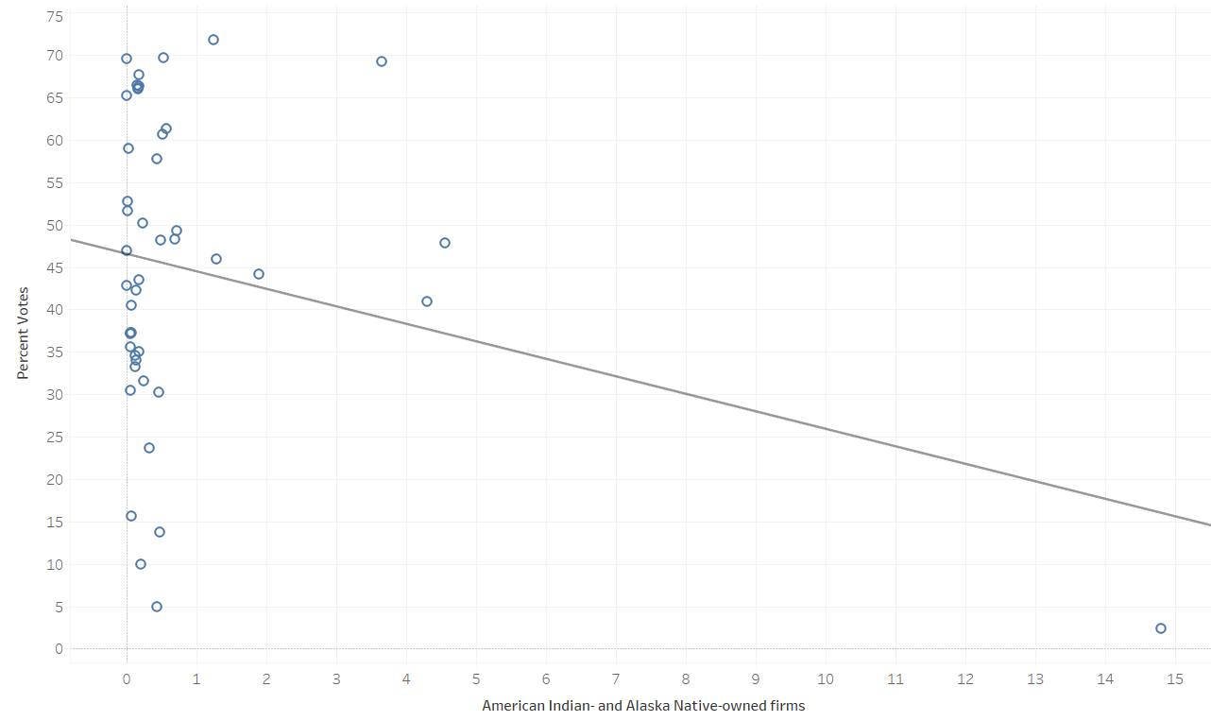
Notes:
Need to address voting gaps
Przeskalowac glosy zeby dopelnic do 100
Zrobic wykresy w tabeau

Slide 14
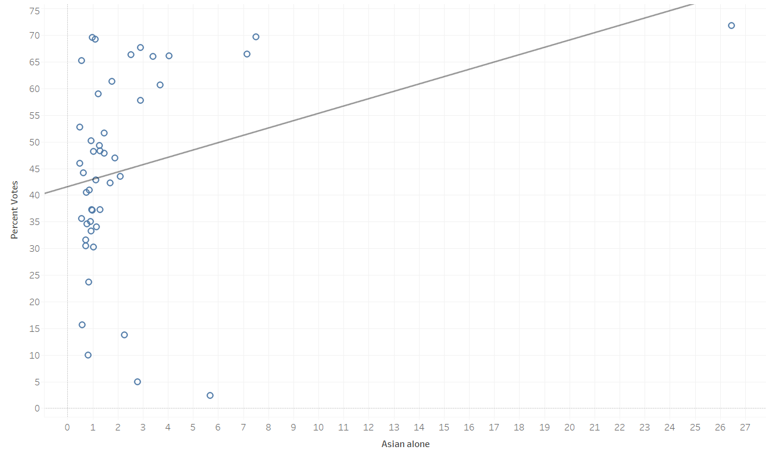
Notes:
Need to address voting gaps
Przeskalowac glosy zeby dopelnic do 100
Zrobic wykresy w tabeau

Slide 15
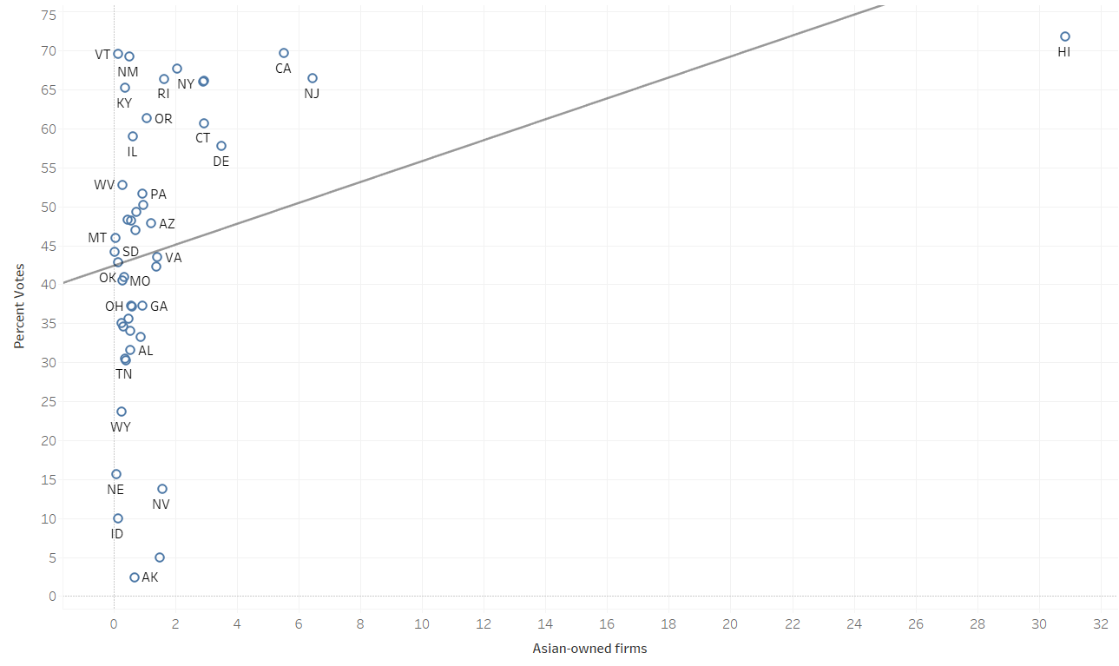
Notes:
Need to address voting gaps
Przeskalowac glosy zeby dopelnic do 100
Zrobic wykresy w tabeau

Slide 16
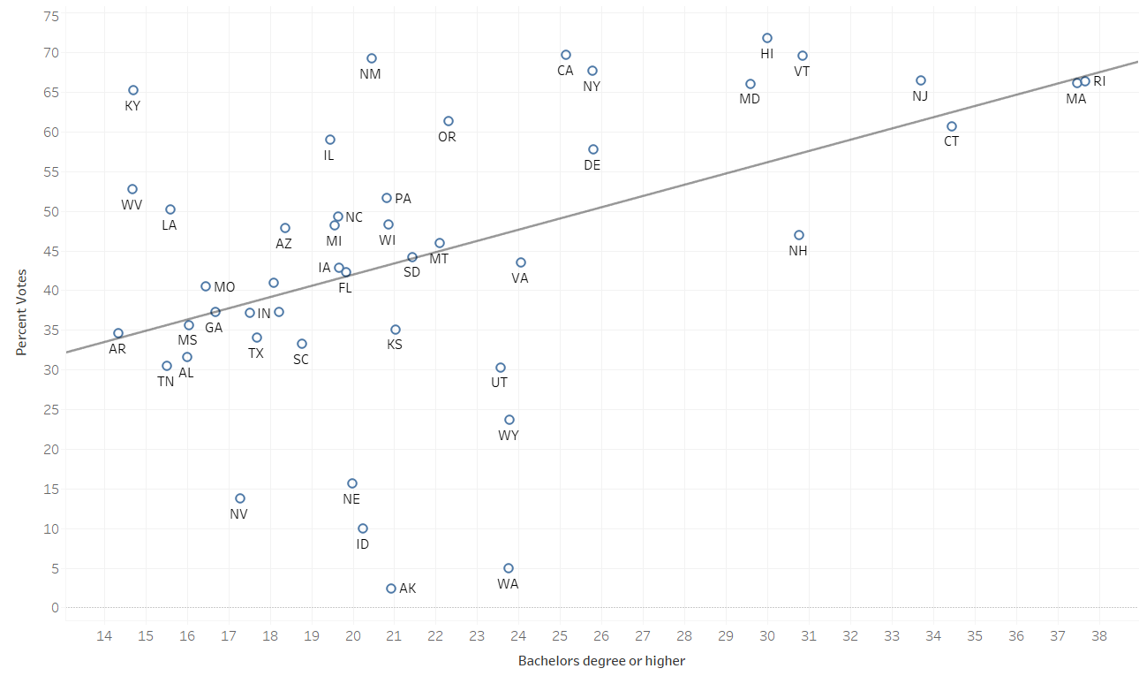
Notes:
Need to address voting gaps
Przeskalowac glosy zeby dopelnic do 100
Zrobic wykresy w tabeau

Slide 17
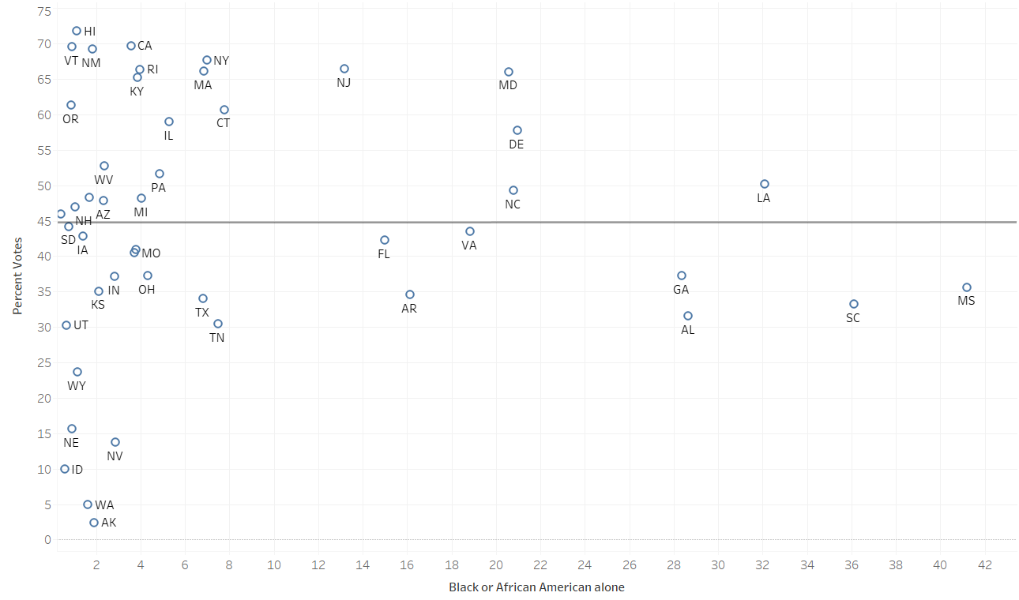
Notes:
Need to address voting gaps
Przeskalowac glosy zeby dopelnic do 100
Zrobic wykresy w tabeau

Slide 18
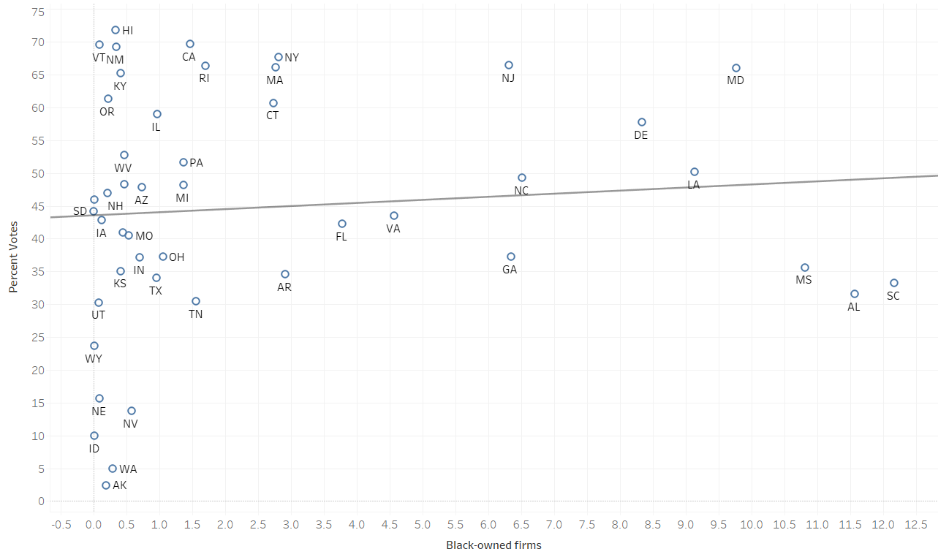
Notes:
Need to address voting gaps
Przeskalowac glosy zeby dopelnic do 100
Zrobic wykresy w tabeau

Slide 19
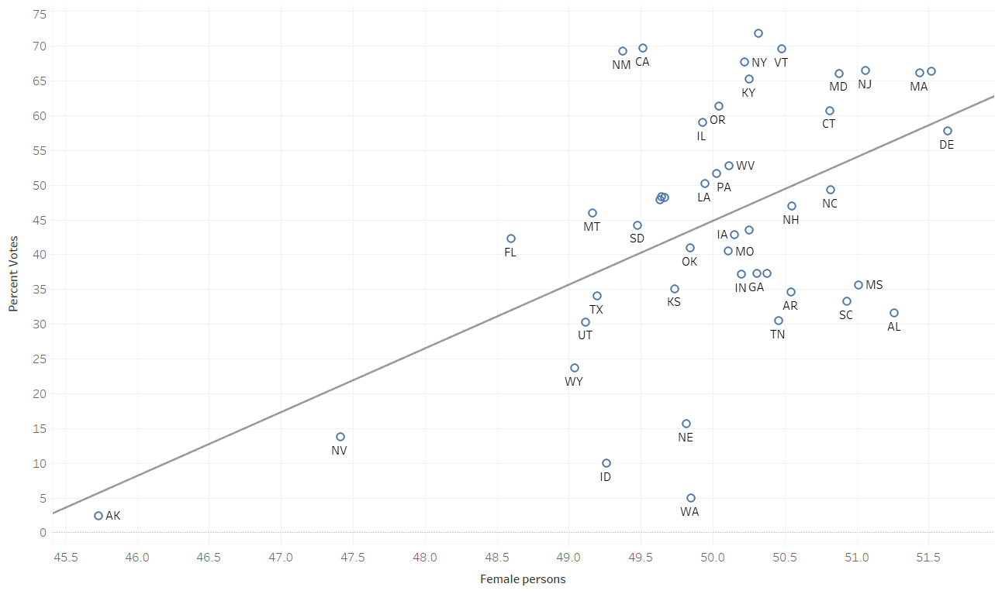
Notes:
Need to address voting gaps
Przeskalowac glosy zeby dopelnic do 100
Zrobic wykresy w tabeau

Slide 20
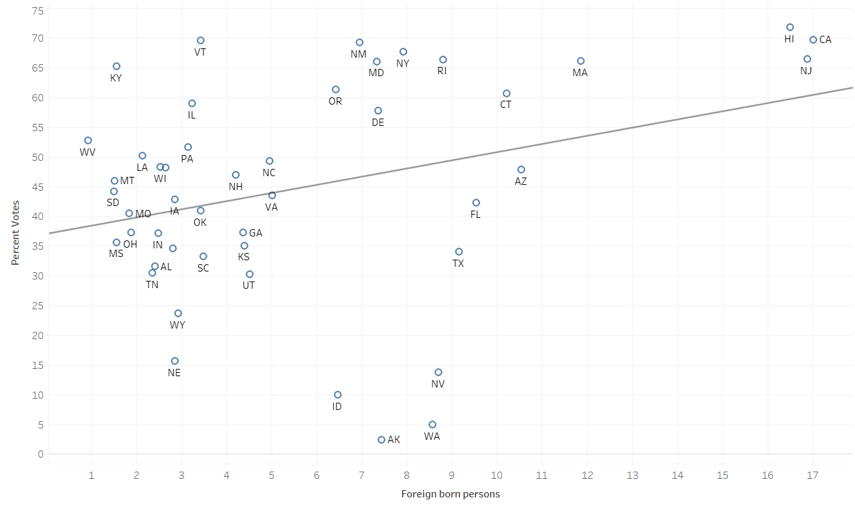
Notes:
Need to address voting gaps
Przeskalowac glosy zeby dopelnic do 100
Zrobic wykresy w tabeau

Slide 21
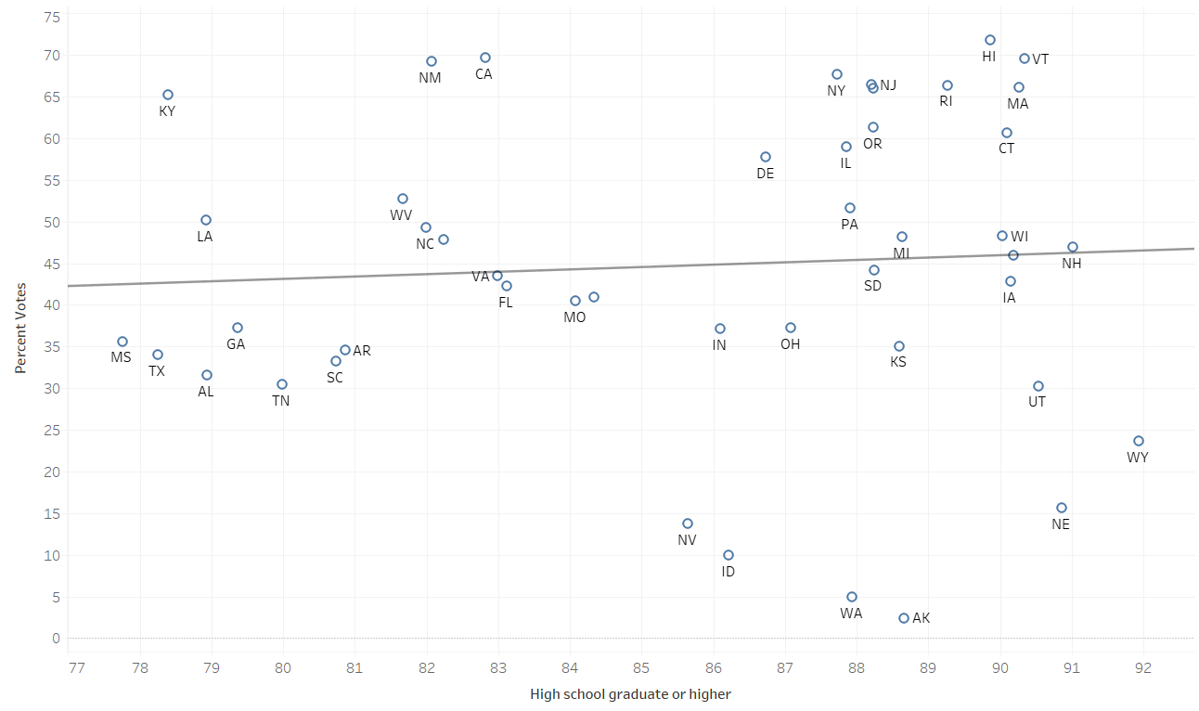
Notes:
Need to address voting gaps
Przeskalowac glosy zeby dopelnic do 100
Zrobic wykresy w tabeau

Slide 22
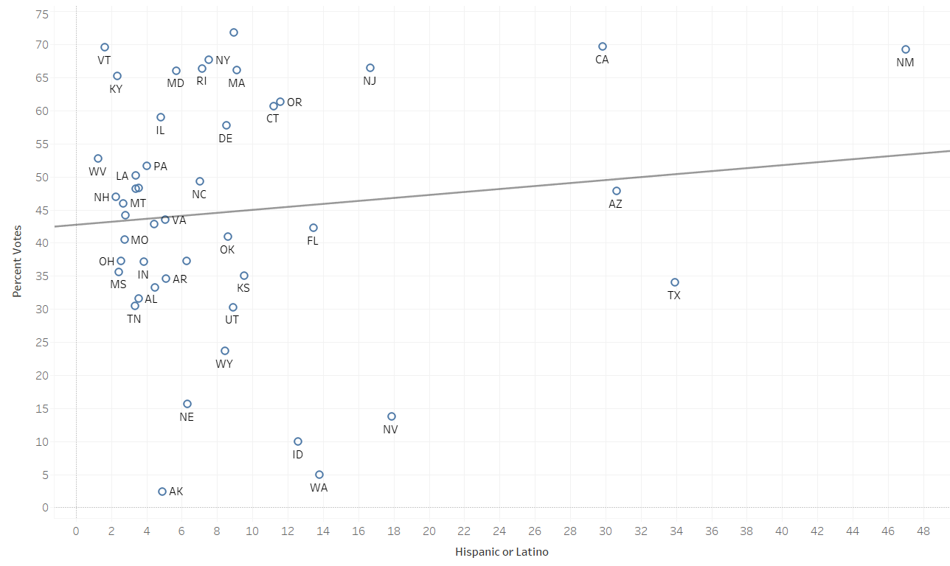
Notes:
Need to address voting gaps
Przeskalowac glosy zeby dopelnic do 100
Zrobic wykresy w tabeau

Slide 23
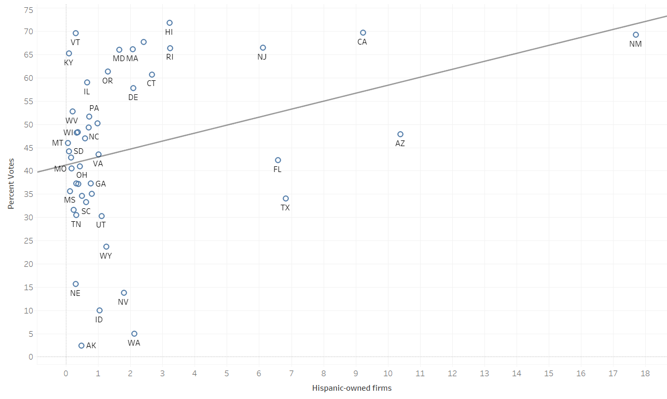
Notes:
Need to address voting gaps
Przeskalowac glosy zeby dopelnic do 100
Zrobic wykresy w tabeau

Slide 24
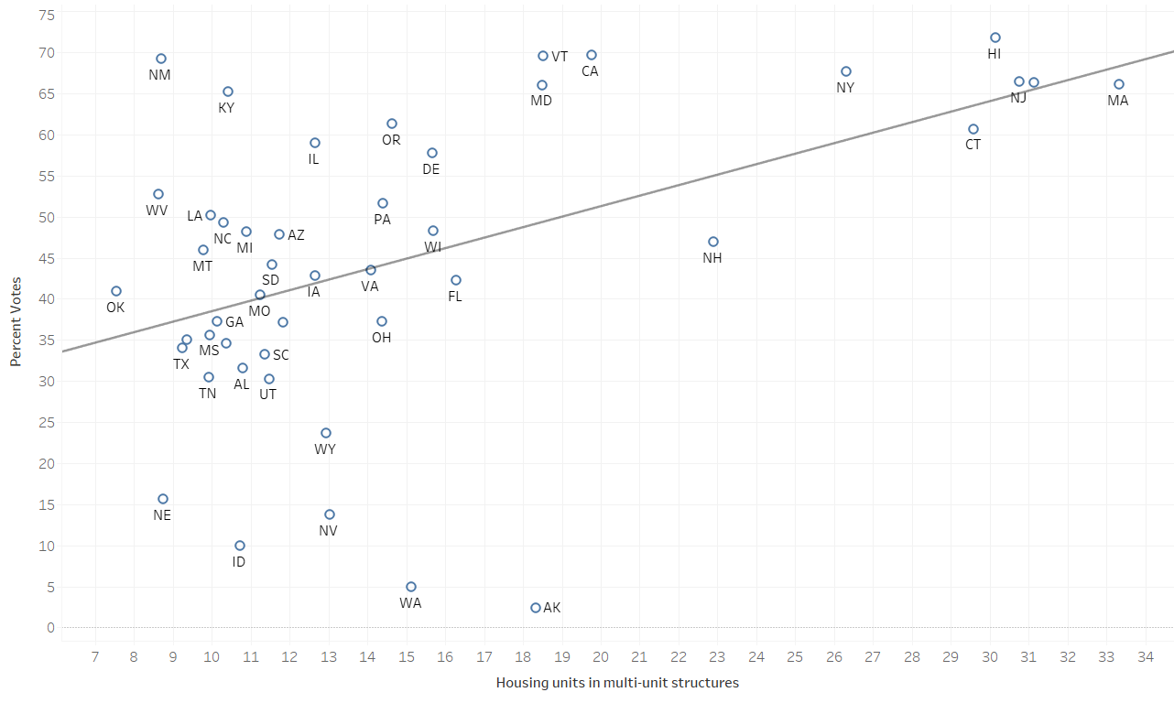
Notes:
Need to address voting gaps
Przeskalowac glosy zeby dopelnic do 100
Zrobic wykresy w tabeau

Slide 25
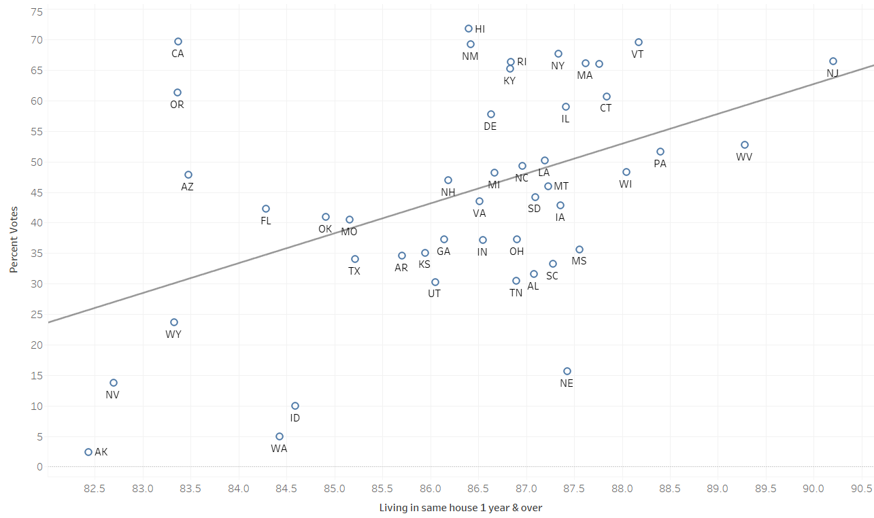
Notes:
Need to address voting gaps
Przeskalowac glosy zeby dopelnic do 100
Zrobic wykresy w tabeau

Slide 26
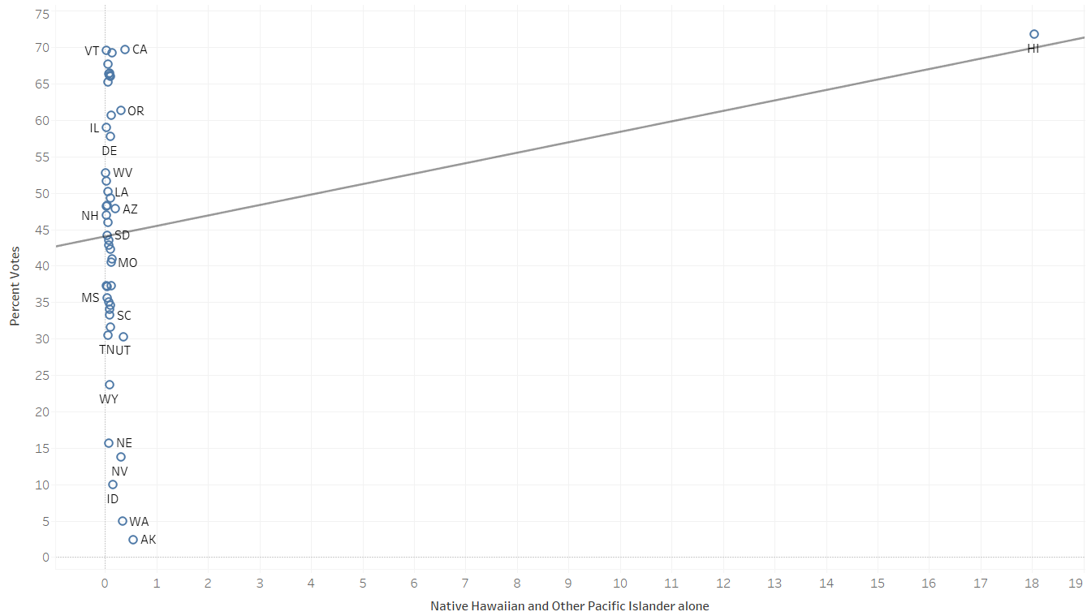
Notes:
Need to address voting gaps
Przeskalowac glosy zeby dopelnic do 100
Zrobic wykresy w tabeau

Slide 27
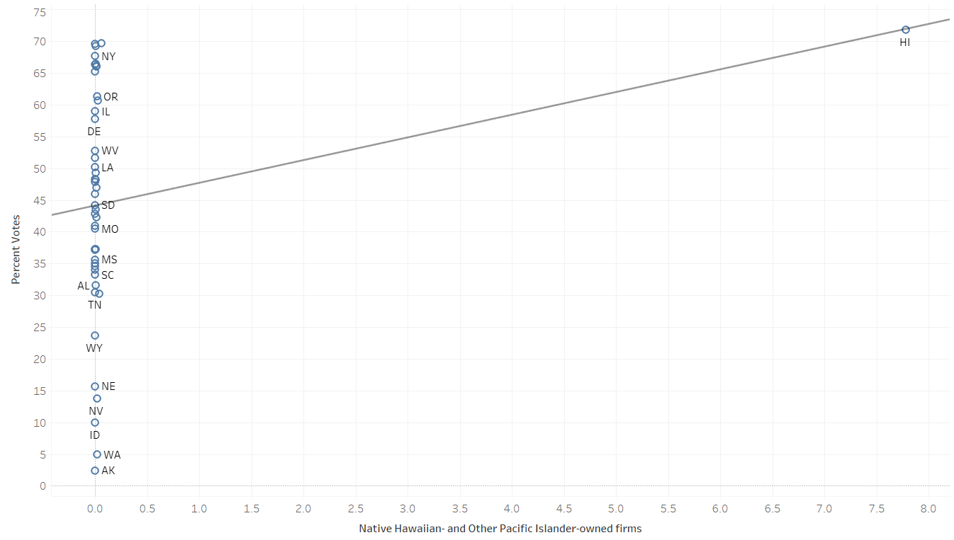
Notes:
Need to address voting gaps
Przeskalowac glosy zeby dopelnic do 100
Zrobic wykresy w tabeau

Slide 28
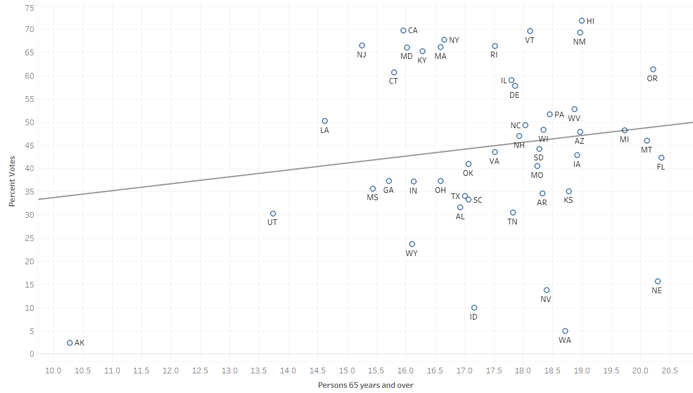
Notes:
Need to address voting gaps
Przeskalowac glosy zeby dopelnic do 100
Zrobic wykresy w tabeau

Slide 29
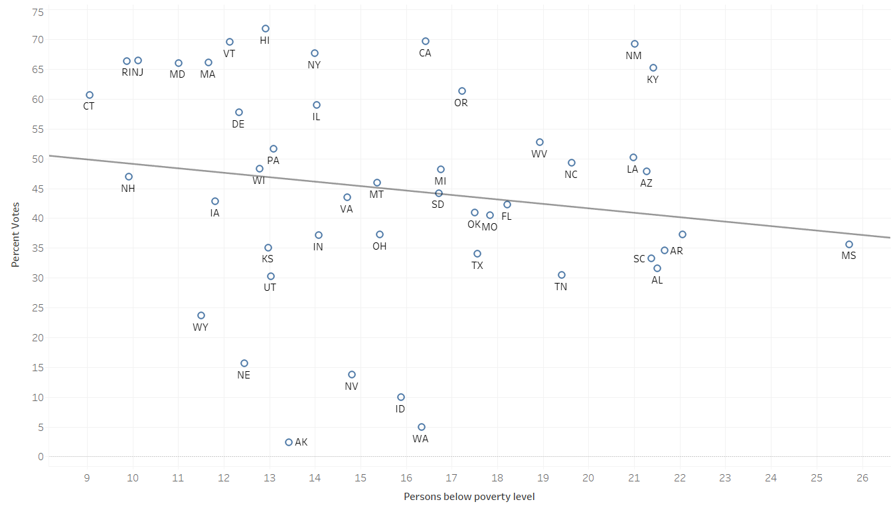
Notes:
Need to address voting gaps
Przeskalowac glosy zeby dopelnic do 100
Zrobic wykresy w tabeau

Slide 30
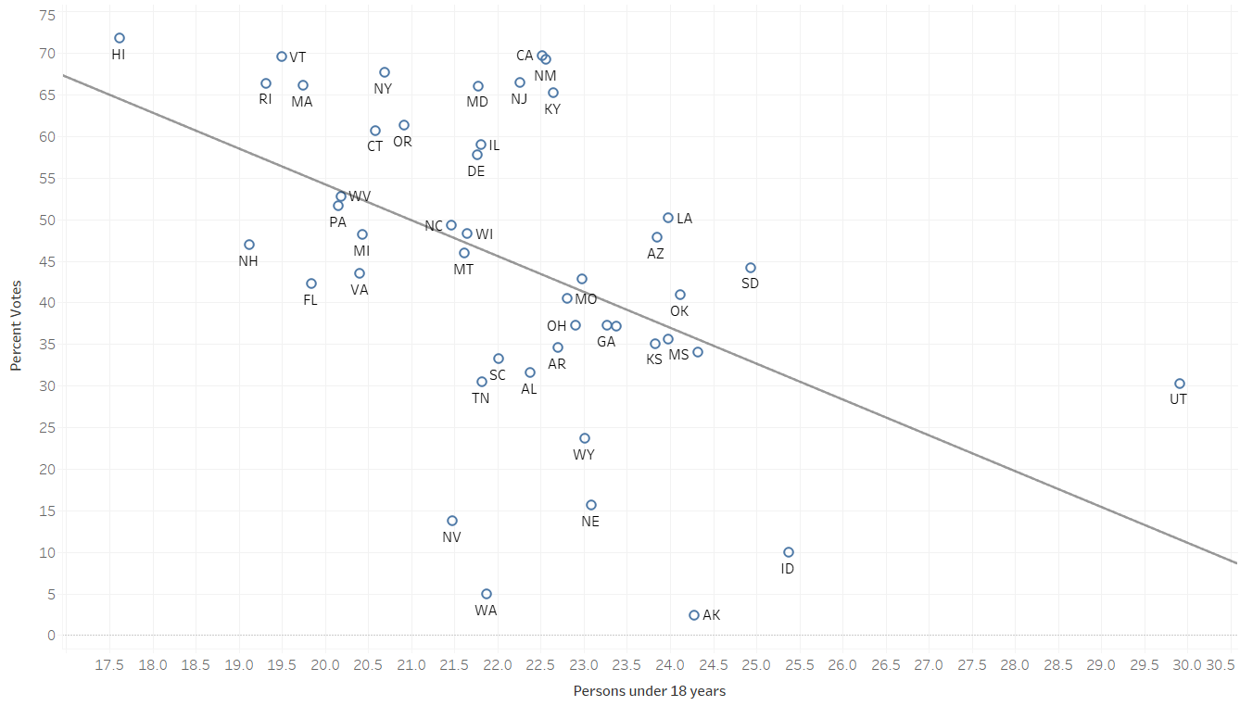
Notes:
Need to address voting gaps
Przeskalowac glosy zeby dopelnic do 100
Zrobic wykresy w tabeau

Slide 31
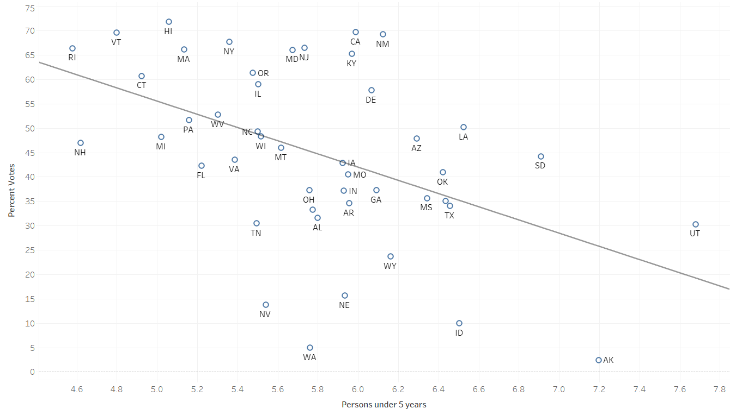
Notes:
Need to address voting gaps
Przeskalowac glosy zeby dopelnic do 100
Zrobic wykresy w tabeau

Slide 32
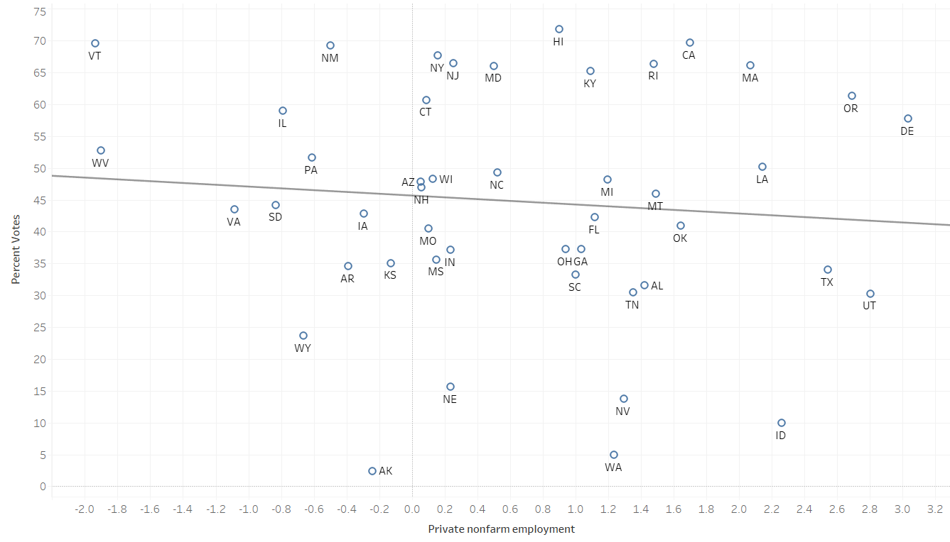
Notes:
Need to address voting gaps
Przeskalowac glosy zeby dopelnic do 100
Zrobic wykresy w tabeau

Slide 33
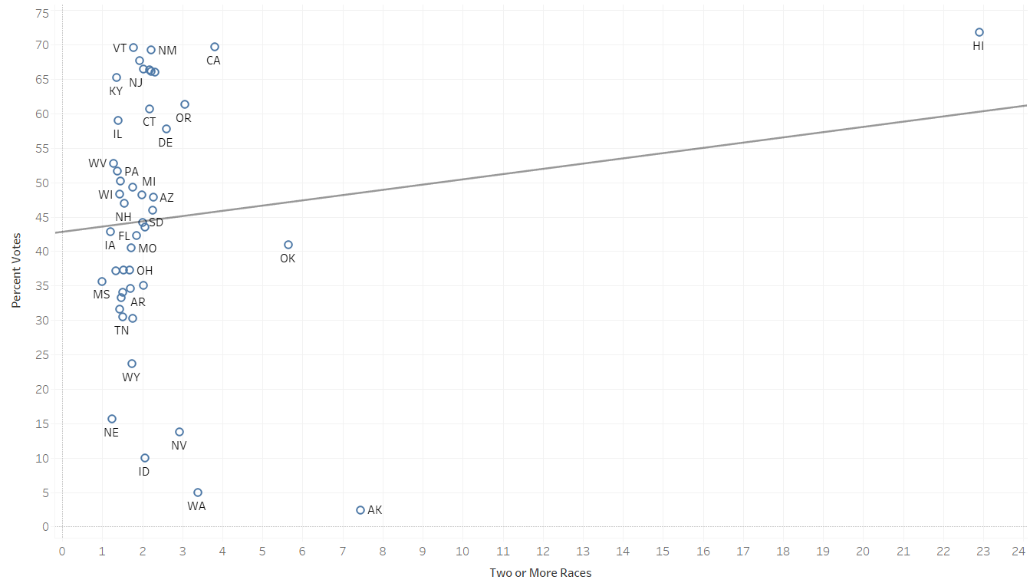
Notes:
Need to address voting gaps
Przeskalowac glosy zeby dopelnic do 100
Zrobic wykresy w tabeau

Slide 34
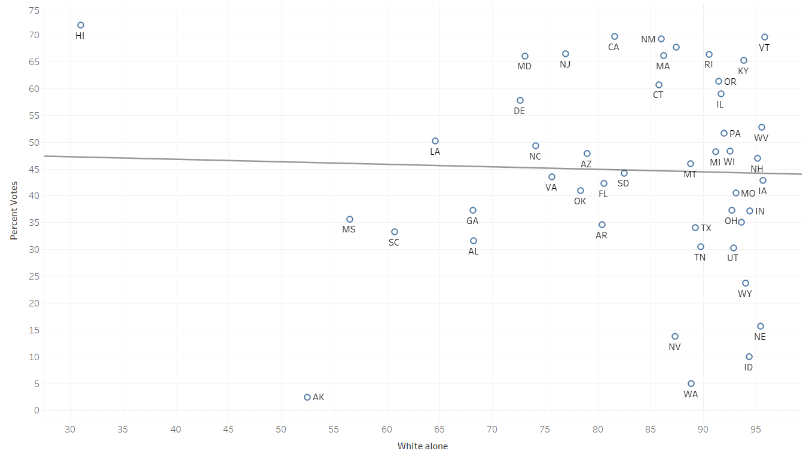
Notes:
Need to address voting gaps
Przeskalowac glosy zeby dopelnic do 100
Zrobic wykresy w tabeau

Slide 35
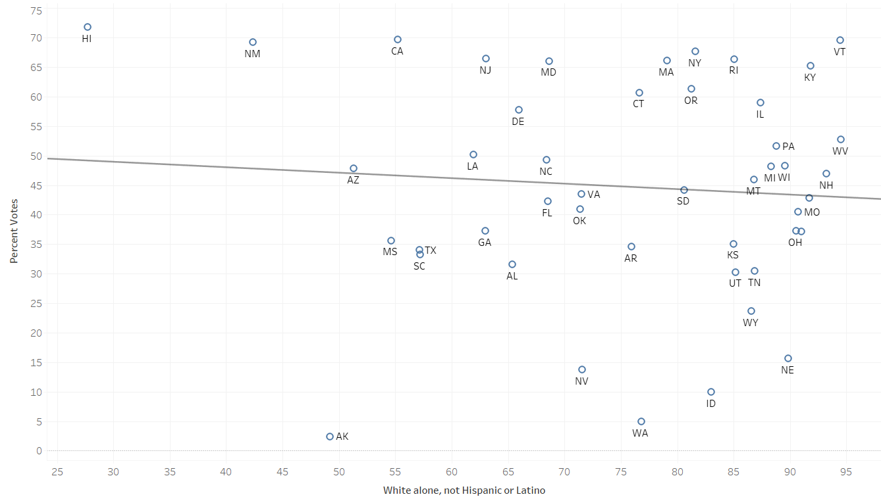
Notes:
Need to address voting gaps
Przeskalowac glosy zeby dopelnic do 100
Zrobic wykresy w tabeau

Slide 36
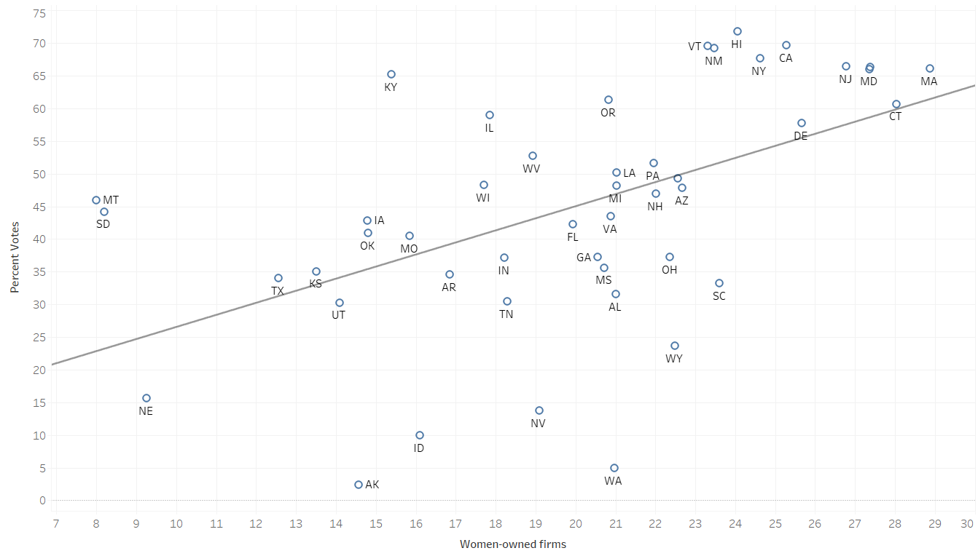
Notes:
Need to address voting gaps - need to check votes/state population as %
Przeskalowac glosy zeby dopelnic do 100 - no need to scale as we are only checking relation between % of votes and % of stat
Zrobic wykresy w tabeau - done

